Slide 1
HireHub - DFD

Slide 2
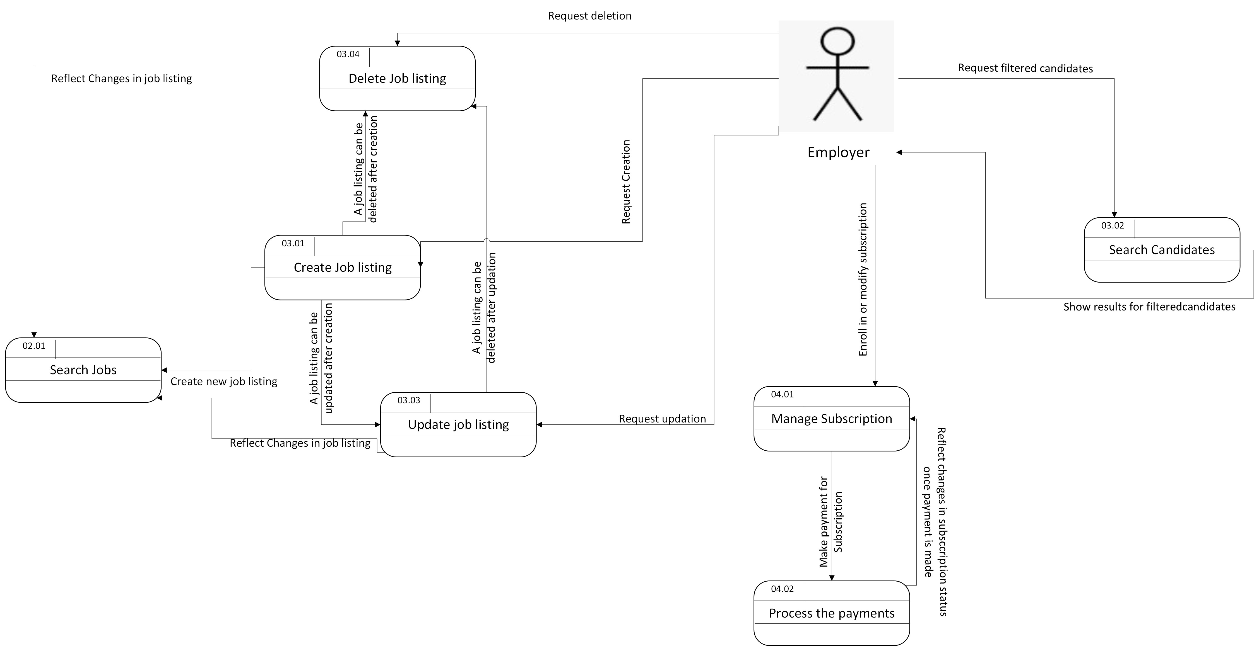
HireHub – Logical DFD

Slide 3
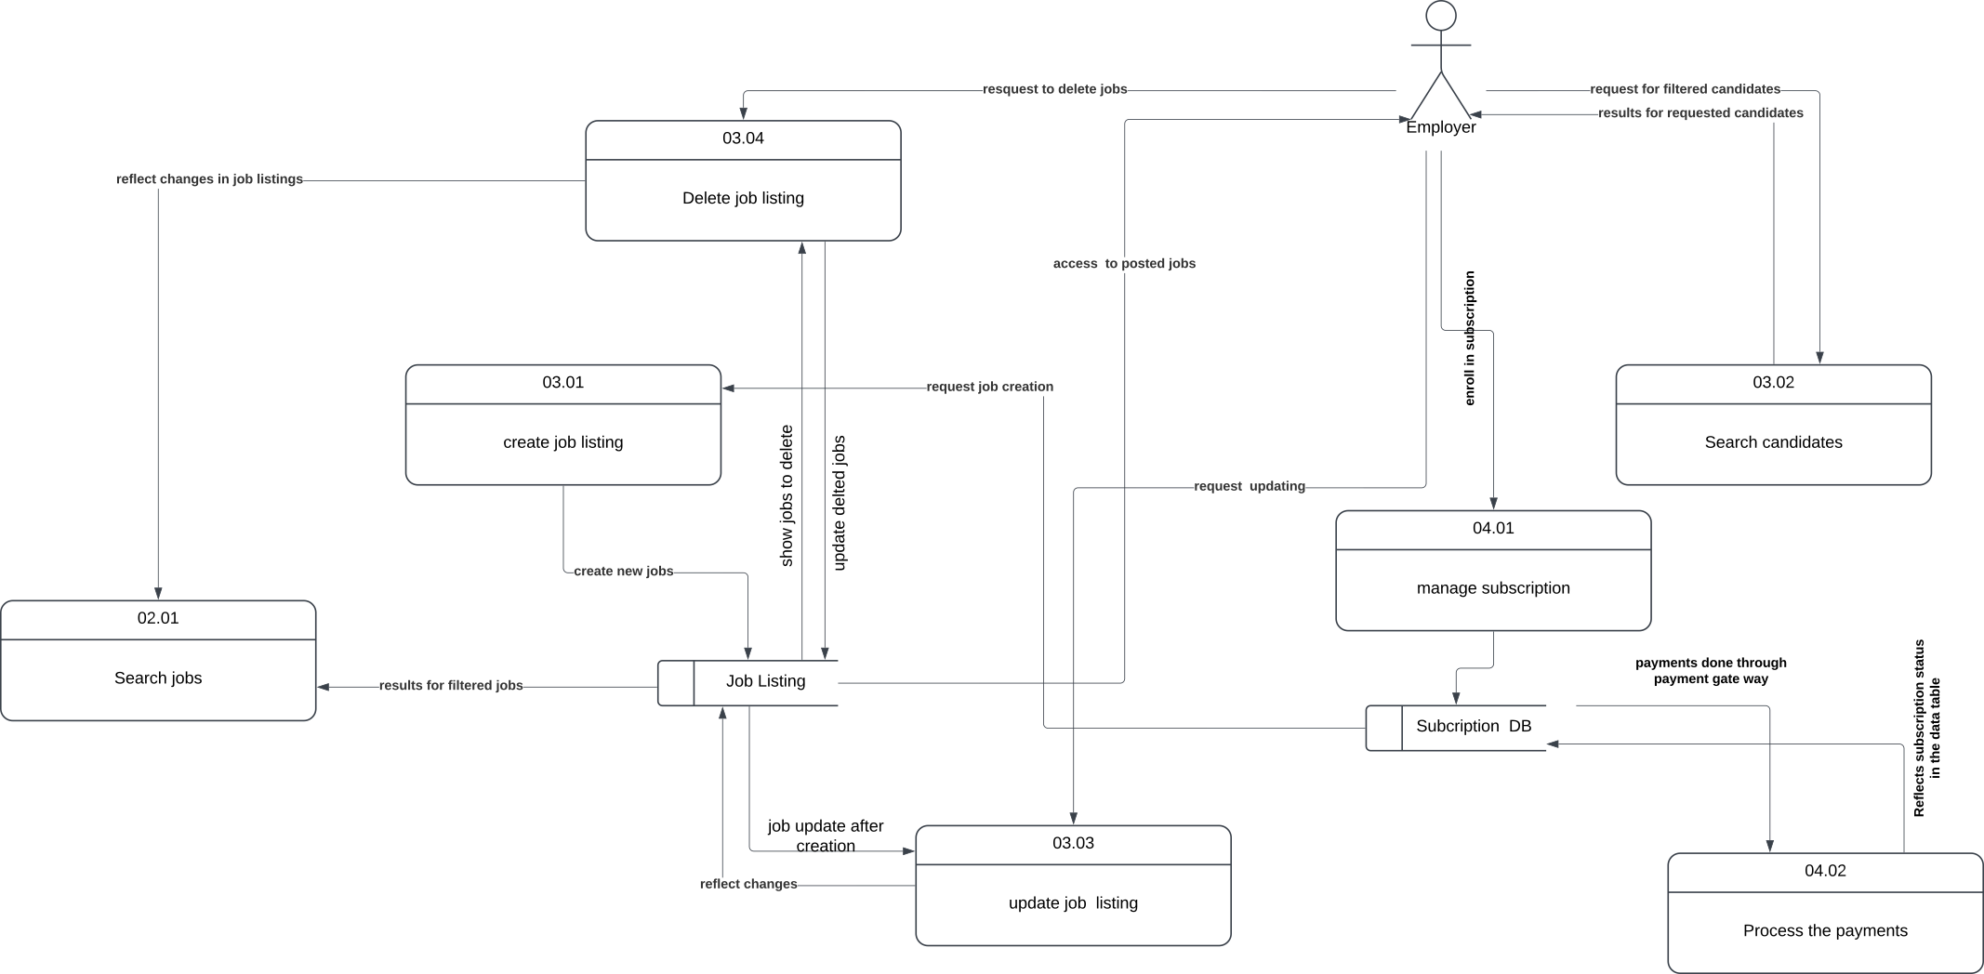
HireHub – Physical DFD

